Slide 1

Building a Faster RCNN model for object detection from scratch
Peihang Xu
https://github.com/RockyXu66/Faster_RCNN_for_Open_Images_Dataset_Keras
Ren, S., He, K., Girshick, R., & Sun, J. (2015). Faster r-cnn: Towards real-time object detection with region proposal networks. In Advances in neural information processing systems (pp. 91-99).

Slide 2
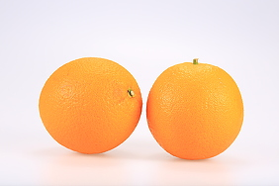

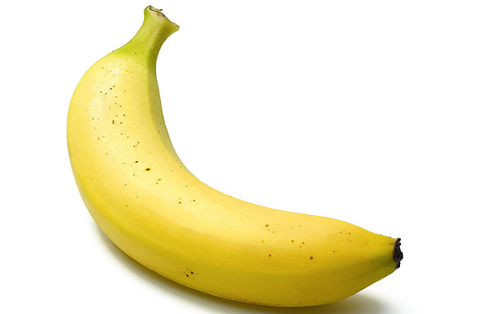
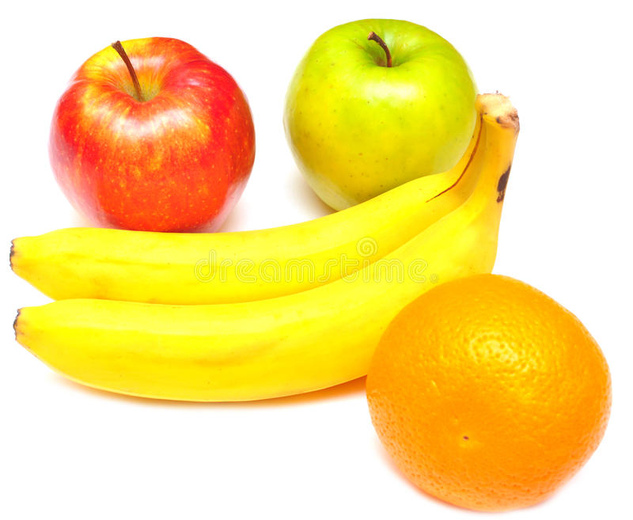
Task – Detecting apples/oranges/bananas

Slide 3
Data
Simple task and simple data
240 images train + 60 images test with various resolutions
Images contain one or multiple objects
https://www.kaggle.com/mbkinaci/fruit-images-for-object-detection

Slide 4
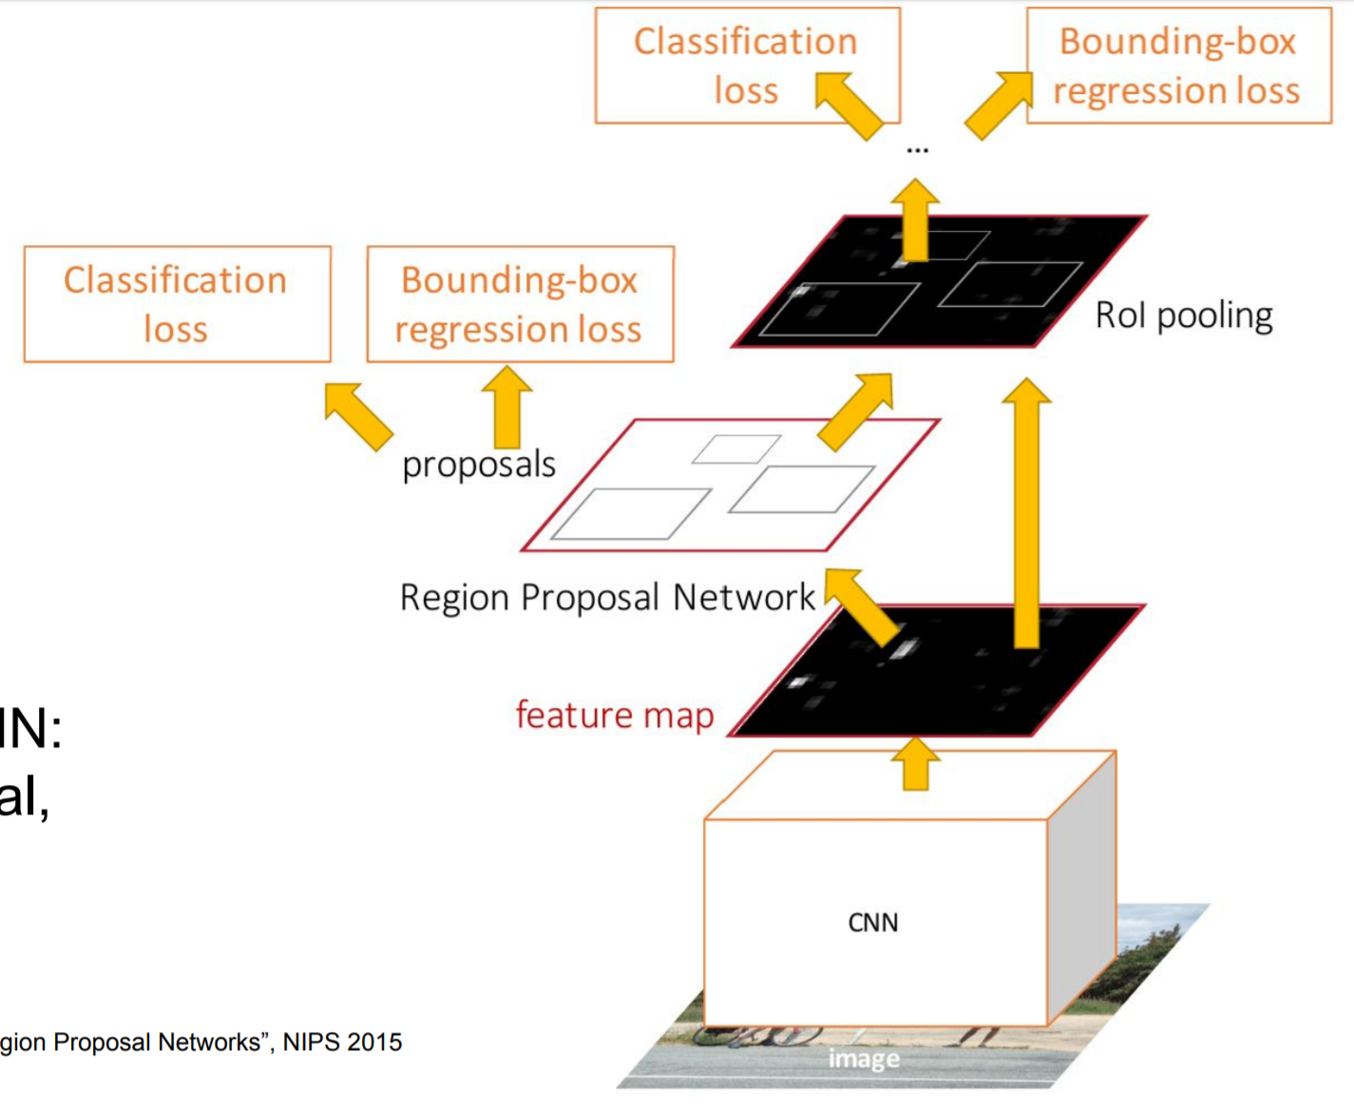
The model
First stage: RPN
- Region proposal network
- Run once per image
- Fully convolutional network
VGG-16
Fei-Fei Li, Ranjay Krishna, Danfei Xu, Lecture slides, 12

Slide 5
The model
Second stage: classifier
- Run once per region
- Crop features: RoI pool / align
- Predict object class
- Prediction bbox offset
VGG-16
Fei-Fei Li, Ranjay Krishna, Danfei Xu, Lecture slides, 12

Slide 6
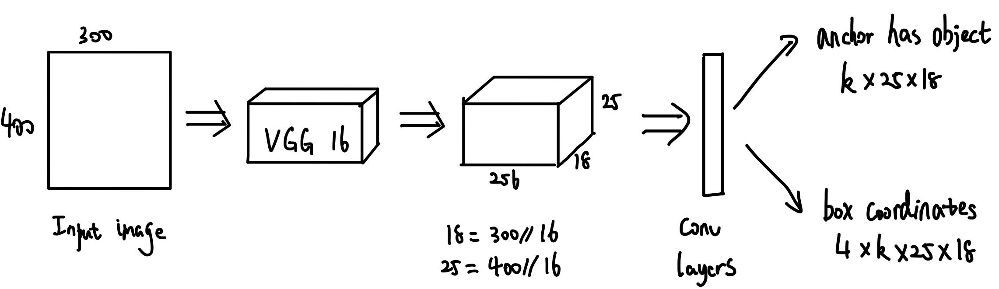
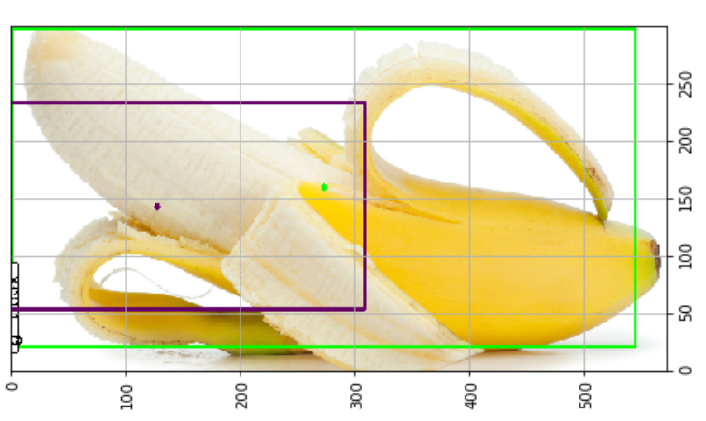
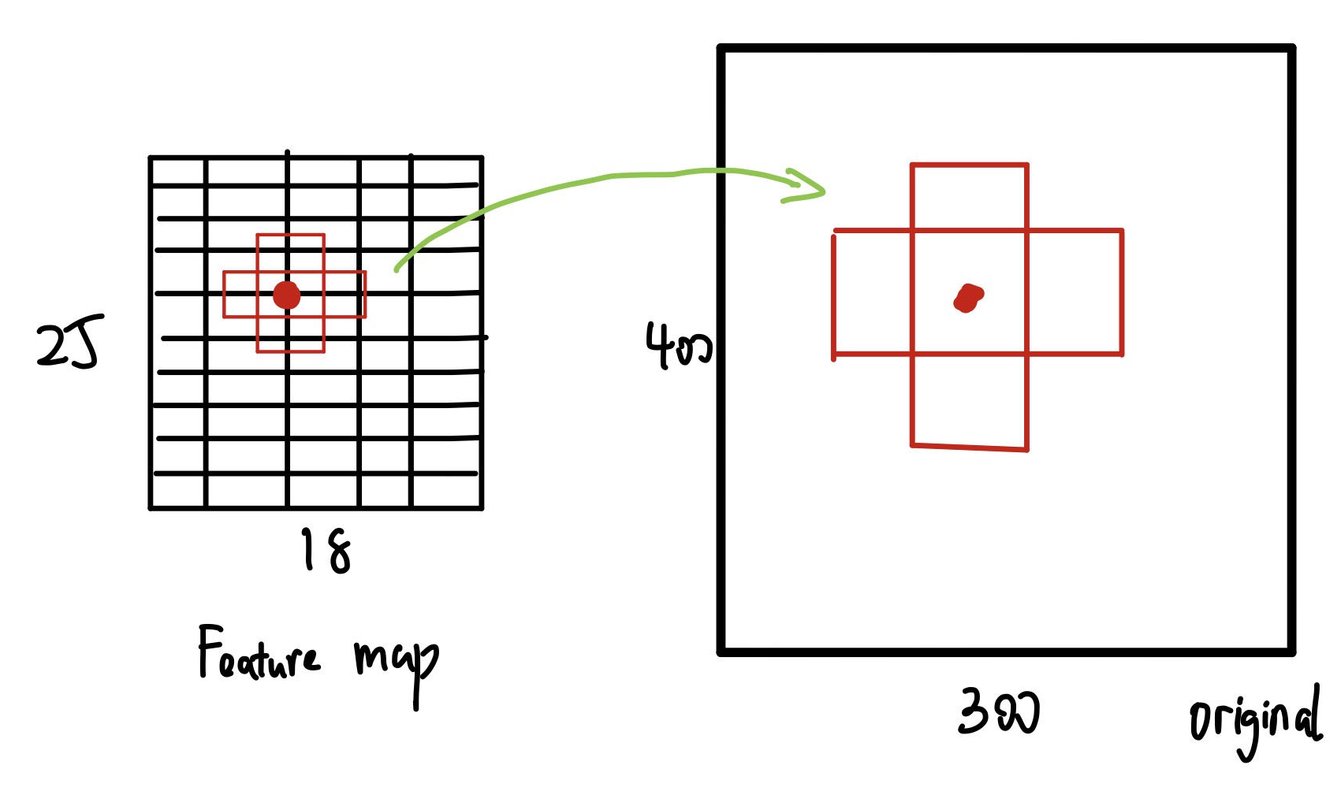
Key Concept explanations: stage 1 RPN
Two outputs and losses
Propose k anchor boxes of fixed different size / scale at each anchor point in the feature map
At each point, predict whether the corresponding anchor boxes contain an object
Sort the k*25*18 boxes by their “objectness” score, take top ~300 as our final proposals that we will feed to the classifier

Slide 7
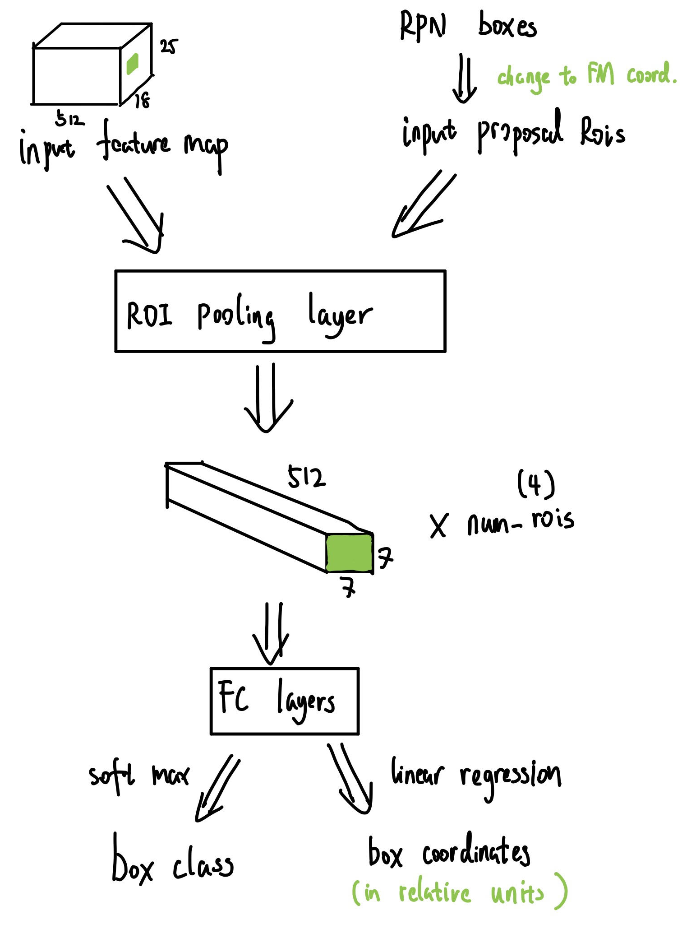
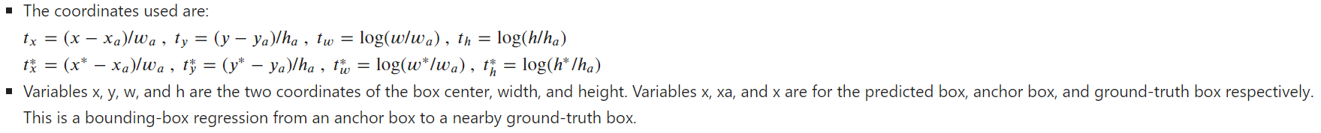
Key Concept explanations: stage 2 classifier
RoIPooling: process the roi to a specific size output by max pooling
Every input roi is divided into some sub-cells 7x7, and we applied max pooling to each
Before sending proposal boxes to the classifier, for positive boxes, propose corrections from the anchor box to the ground-truth box

Slide 8
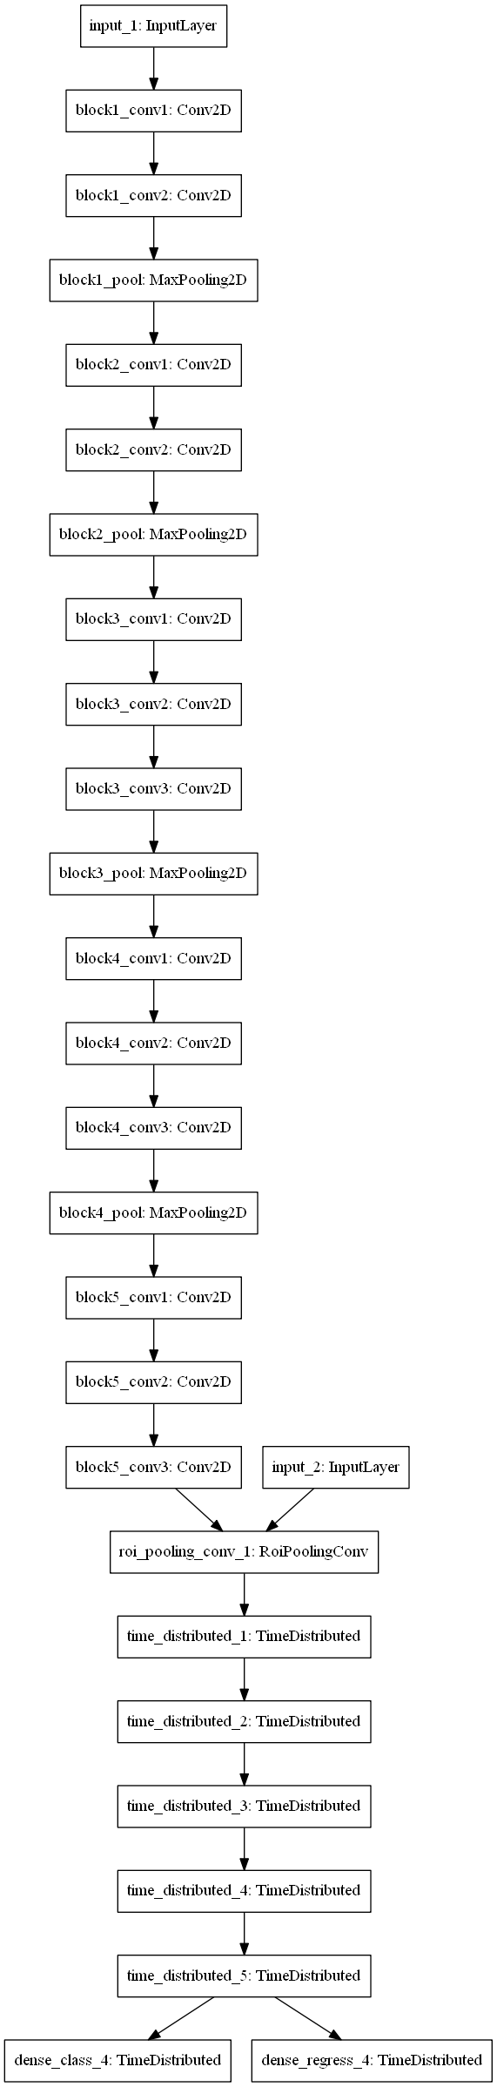
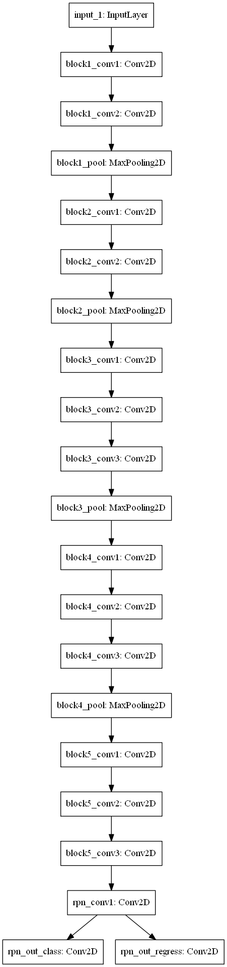
RPN
classifier

Slide 9
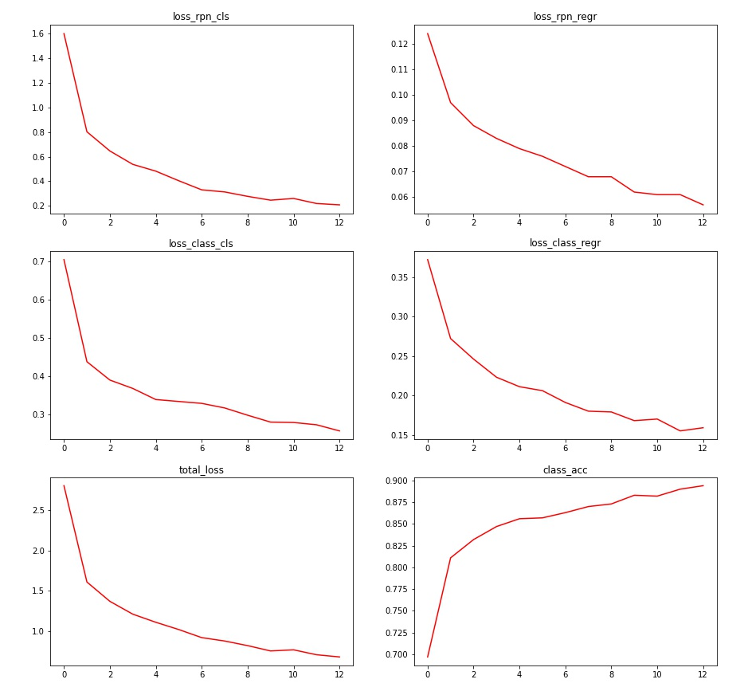
Results
Training progress
1000 images trained per epoch
4 num_rois trained per image

Slide 10
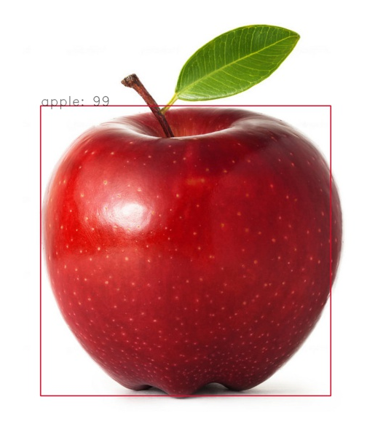
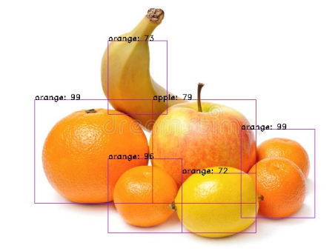
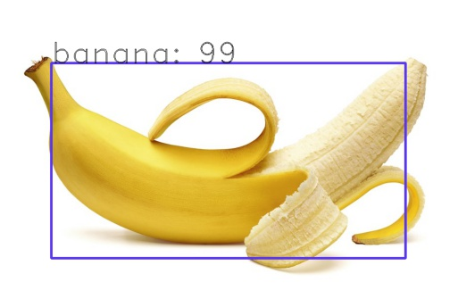
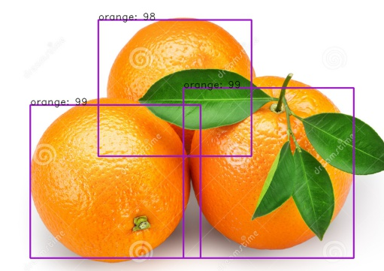
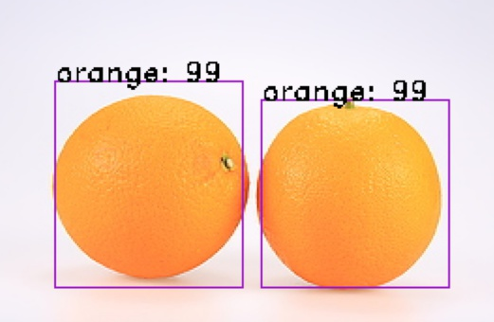
Results

Slide 11
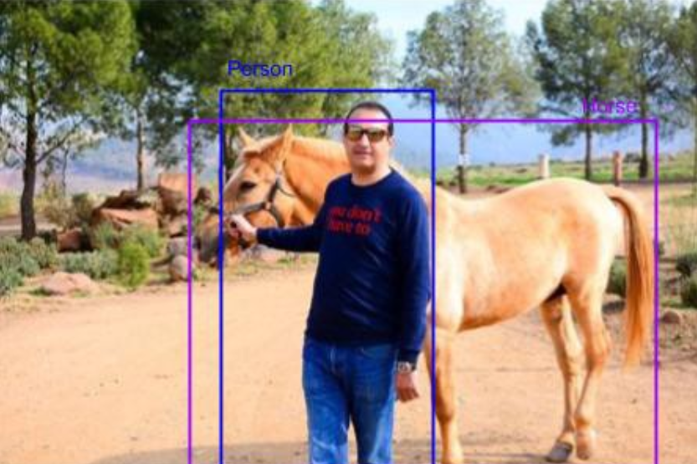
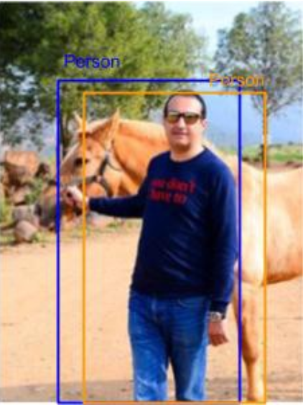
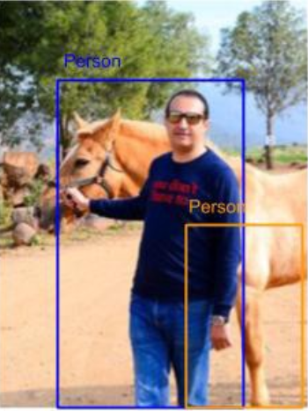
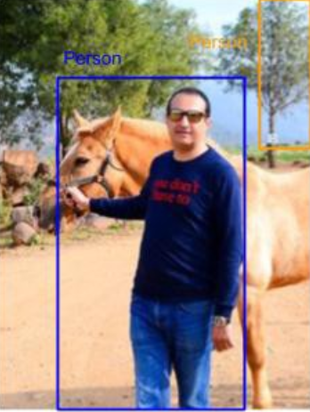


Metric: Mean average precision
The IoU would be used to determine if a predicted bounding box (BB) is TP, FP or FN
TP
FP
FP
FN
FN
https://towardsdatascience.com/breaking-down-mean-average-precision-map-ae462f623a52

Slide 12
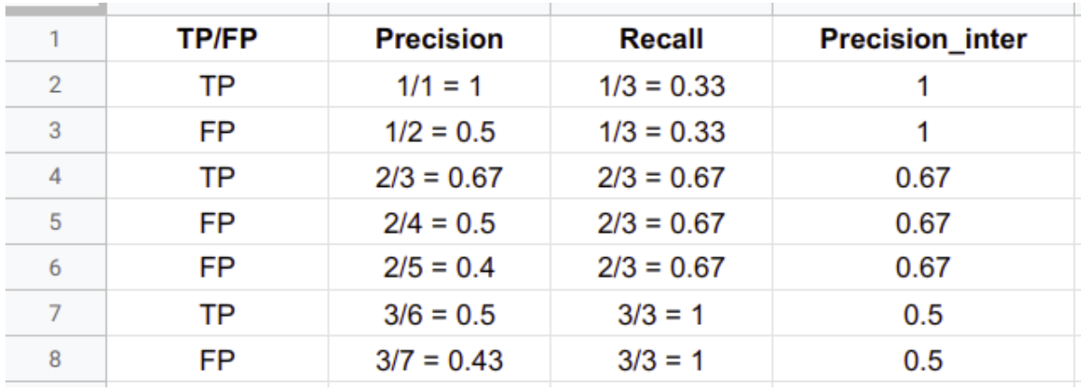
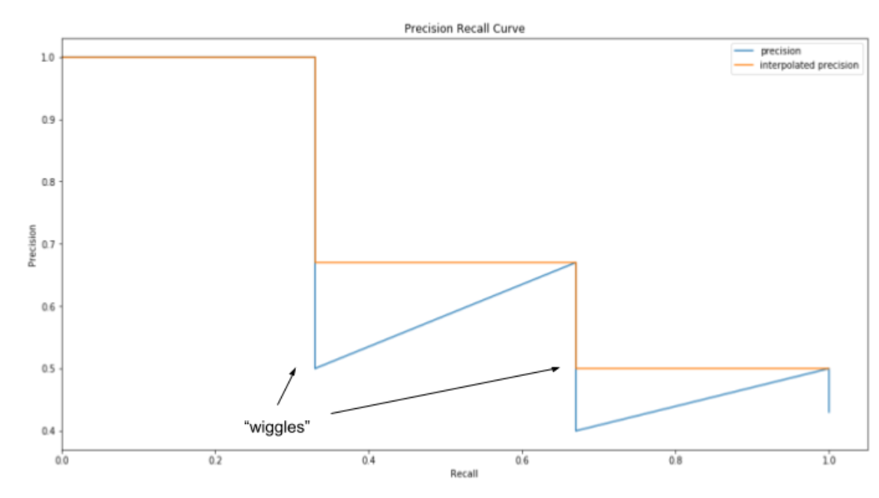
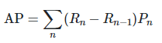
Metric: Mean average precision
Precision = TP/(TP+FP)
Recall = TP/(TP+FN)
Consider an example with 3 TP, 4 FP and 2 FN. We calculate the corresponding precision, recall
AP is then calculated by taking the area under the PR curve
Weighted mean of precisions achieved at each threshold, with the increase in recall from the previous threshold used as the weight:
mAP for object detection is the average of the AP calculated for all the classes
https://towardsdatascience.com/breaking-down-mean-average-precision-map-ae462f623a52

Slide 13
Thanks to sklearn
Just use “sklearn.metrics.average_precision_score”
sklearn.metrics.average_precision_score(y_true, y_score, *, average='macro', pos_label=1, sample_weight=None)

Slide 14
Hyperparameters tuning
 | VGG-16 without last max-pooling | VGG-16 with last max-pooling | Without data augmentation | 400 as min size of image | Num rois training each time from 4->6
Mean Average Precision for train set | 0.924 | 0.878 | 0.890 | 0.822 | 0. 938
Mean Average Precision for test set | 0.912 | 0.846 | 0.753 | 0.783 | 0.886
Best, 1/16 ratio to feature map
1/32 ratio
Clearly
overfitting
Clearly
overfitting

Slide 15
Future work
Tons of other hyperparameters to tune ➔ multiple dimensional random walk hyperparameter tuning?
Try training and testing on more complicated data (e.g. PASCAL VOC and MS COCO datasets, or mask/no-mask dataset)

